Slide 1
Arrays
February 24, 2014
Notes:
Guidewire training materials contain Guidewire proprietary information that is subject to confidentiality and non-disclosure agreements. You agree to use the information in this manual solely for the purpose of training to implement Guidewire software solutions. You also agree not to disclose the information in this manual to third parties or copy this manual without prior written consent from Guidewire. Guidewire training may be given only by Guidewire employees or certified Guidewire partners under the appropriate agreement with Guidewire.

Slide 2
Describe what is an array
Determine the number of elements in an array
Loop through each object in an array
Add object to (and remove object from) an array
Determine if any objects with a given criterion exists in an array
Retrieve objects in an array that match a given criterion

Slide 3
Arrays
Array method expressions

Slide 4
Arrays
Data model entity array
Derived API entity array
Gosu datatype and object array
<array /> on parent entity to array entity
<foreignkey /> on array entity to parent entity
Example:
ABContact defines FlagEntries array
Entity enhancement or Guidewire API
Example:
ABContact AllAddresses property returns an Address array
A set of values are of the same type in a single collection
Examples
var a = new int[3]
var b = new int[ ] {1,2,3}
var c : int[ ] = {1,2,3}
Notes:
Configuration of Guidewire applications often focus on working with data model entity arrays. An array defines a set of additional entities of the same type to associate with the main entity.
A related data model array is the associative array. An associative array provides a mapping between a set of keys and the values that the keys represent. A common example of this type of mapping is a telephone book, in which a name maps to a telephone number. Another common example is a dictionary, which maps terms to their definitions.
An array is a collection of data values, with each element of the array associated with a number or index.
In typical Gosu code, simply use angle brackets after the type name, such as String[] to represent an array of String objects. Use a zero-based index number to access an array member. If you create an array, you must explicitly define the size of the array or implicitly define the size by simultaneously defining the array elements. To access the elements of an array, you use an index expression.

Slide 5
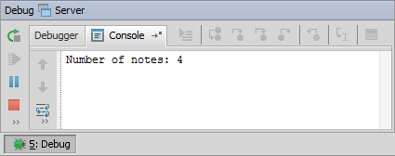
Array length
1 uses ta.QueryUtil 2 var out : String = "Notes"
3 var anABContact = QueryUtil.findContact("5")
4 var notes = anABContact.ContactNotes
5 print(out + notes.length)
Determine the length (size) of an array
Syntax:
arrayName.length
Notes:
The array.Count property is an ehancement property for determining the number of element (objects) in the array.
You can execute the code in the slide example in the Debug Server process. To debug the server, select Main menu → Run → Debug 'Server' or Main menu → Run → Debug… → Server. In the Debug tools window, confirm that the application is running and is ready (***** AppName ready *****). Then, open Gosu Scratchpad using Main menu → Tools → Gosu Scratchpad or with the keystroke ALT+SHIFT+S. In Gosu Scratchpad toolbar, click Run in Debug Process.

Slide 6
Iterate through array with a loop
1 uses ta.QueryUtil 2 var out : String = ""
3 var anABContact = QueryUtil.findContact("5")
4 var notes = anABContact.ContactNotes
5 for (note in notes) {
6 out += note.ContactNoteType + "-" + note.Subject + "\n"
7 }
8 print(out)
Use loop structure to iterate through array
Entity array, object array, collection
Counter varaible, condition, and variable incrementer not needed
Syntax:
for(aObject in anArrayOfObjects) {
//statements referencing aObject
}
Notes:
Many programming langauges create a loop using a counter variable, a condition, and a counter variable incrementer, such as:
for (x=0, x<anArray.length, x++) {
// statements referencing anArray[x]
}
The syntax for Gosu loops does not require a counter, condition, and incrementer. You only need specify a name for the current object (the currentObject placeholder). The name of the object automatically references the current object in the array. The for loop inherently advances to the next object in the array when the end of the loop is reached.
Gosu also supports these While and Do…While loops, but in practice they are often not needed. For more information, refer to the Gosu Reference Guide
You can execute the code in the slide example in the Debug Server process. To debug the server, select Main menu → Run → Debug 'Server' or Main menu → Run → Debug… → Server. In the Debug tools window, confirm that the application is running and is ready (***** AppName ready *****). Then, open Gosu Scratchpad using Main menu → Tools → Gosu Scratchpad or with the keystroke ALT+SHIFT+S. In Gosu Scratchpad toolbar, click Run in Debug Process.

Slide 7
Add an index for a loop
1 uses ta.QueryUtil 2 var out : String = ""
3 var anABContact = QueryUtil.findContact("5")
4 var notes = anABContact.ContactNotes
5 for (note in notes index i) {
6 out += i + ")" note.ContactNoteType + "-" + note.Subject + "\n"
7 }
8 print(out)
Add an index using the index keyword
Syntax:
for(aObject in anArrayOfObjects index indexVariable) {
//statements referencing aObject
}
Notes:
You can execute the code in the slide example in the Debug Server process. To debug the server, select Main menu → Run → Debug 'Server' or Main menu → Run → Debug… → Server. In the Debug tools window, confirm that the application is running and is ready (***** AppName ready *****). Then, open Gosu Scratchpad using Main menu → Tools → Gosu Scratchpad or with the keystroke ALT+SHIFT+S. In Gosu Scratchpad toolbar, click Run in Debug Process.

Slide 8
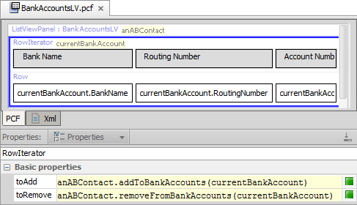
Row iterator array methods
Define experssions in row iterator properties to add and to remove elements from data model entity array
addTo...() and removeFrom...() methods
Notes:
The addTo...() and removeFrom...() methods work only for arrays that are declared in the data model entities.
The slide example is from the BankAccountsLV row iterator. The list view panel is The parent container has a toolbar with Edit buttons and references the BankAccountLV.
Clicking the Add button creates a new bank account object which can be referred to as currentBankAccount. The toAdd property specifies the Gosu to add the object to the BankAccounts array on anABContact.
The addTo and removeFrom methods are available whe Gosu runs in an application context with a current editable object. If you call these methods in Gosu Scratchpad, Scratchpad needs to run in a debug server process and the object needs to be within a bundle transaction scope.

Slide 9
Arrays
Array method expressions

Slide 10
Array methods that require logic
Array methods include
Getting information about the array
Getting members of the array that match a given condition
Some methods require an argument
Argument must be an expression of a condition, such as:
Returns true if any row in the array matches the condition
Returns the first row that matches the condition
Returns all rows that match the condition
Argument must be a Gosu block experession

Slide 11
Blocks argument expression
1
2
3
var notes = someNotes.where( \ note ->
note.NoteType ==
typekey.NoteType.TC_GENERAL )
4
A block is an expression of logic passed to a method as an argument
Some array methods require conditions using a block
The block consists of four parts:
\ , which identifies that the following is a block
An element name representing each element of the array
->, which identifies the start of the condition
A condition, which relates to the element
Notes:
Blocks are used in many situations where a method requires an expression as an input parameter, such as in arrays, queries, and Transaction bundles for database transactions.
Arrays (discussed in Arrays lesson)
Queries (discussed in Queries lesson)
or() - used by queries objects to join multiple conditions together with OR logic
orderBy() - used by result set objects to specify logic for how to order the results in the set (in ascending order)
orderByDescending() - used by result set objects to specify logic for how to order the results in the set (in descending order)
Database transactions and bundles (discussed in Application courses)
runwithNewBundle() - used to create a bundle of run-time objects and then commit data in those objects to the database

Slide 12
Common array methods
hasMatch(condition)
Determine if any element in an array matches a given condition
Syntax: array.hasMatch(\ name -> conditionToMatch)
countWhere(condition)
Returns count of elements that match a given condition in an array
Syntax: array.countWhere(\ name -> conditionToMatch)
firstWhere(condition)
Retrieve the first element in an array that matches a given condition
Syntax: array.firstWhere(\ name -> conditionToMatch)
where(condition)
Retrieves a target array that consists of all the members of a source array that match a given condition
Syntax: array.where(\ name -> conditionToMatch)

Slide 13
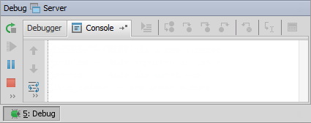
Example: hasMatch()
1 uses ta.QueryUtil 2 var out : String = ""
3 var anABContact = QueryUtil.findContact("5")
4 var notes = anABContact.ContactNotes
5 if (notes.hasMatch( \ note -> note.ContactNoteType == typekey.ContactNoteType.TC_GENERAL )){
6 out += "Array has General notes"
7 }
8 print(out)
Array has General notes
Notes:
In the slide example, Line 5 illustrates an example of a hasMatch() method block for an entity data model array. The hasMatch() method returns a boolean if any of the objects in the source array that match a given condition. In Line 5, the condition statement tests to see if there is a ContactNote for a given contact that has a ContactNoteType with the TC_General typecode.
You can execute the code in the slide example in the Debug Server process. To debug the server, select Main menu → Run → Debug 'Server' or Main menu → Run → Debug… → Server. In the Debug tools window, confirm that the application is running and is ready (***** AppName ready *****). Then, open Gosu Scratchpad using Main menu → Tools → Gosu Scratchpad or with the keystroke ALT+SHIFT+S. In Gosu Scratchpad toolbar, click Run in Debug Process.

Slide 14
Example: countWhere()
1 uses ta.QueryUtil 2 var out : String = ""
3 var anABContact = QueryUtil.findContact("5")
4 var notes = anABContact.ContactNotes
5 var count = notes.countWhere( \ note -> note.ContactNoteType == typekey.ContactNoteType.TC_GENERAL )
6 out += "Number of notes: " + notes.length + "\n"
7 out += "Number of General notes: " + count
8 print(out)
Number of notes: 5
Number of General notes: 2
Notes:
In the slide example, Line 5 illustrates an example of a countWhere() method block for an entity data model array. The countWhere() method returns an integer for the count of all the objects in a source array that match a given condition. In Line 5, the condition statement is to determine if a ContactNote for a given contact has a ContactNoteType with the the TC_General typecode.
You can execute the code in the slide example in the Debug Server process. To debug the server, select Main menu → Run → Debug 'Server' or Main menu → Run → Debug… → Server. In the Debug tools window, confirm that the application is running and is ready (***** AppName ready *****). Then, open Gosu Scratchpad using Main menu → Tools → Gosu Scratchpad or with the keystroke ALT+SHIFT+S. In Gosu Scratchpad toolbar, click Run in Debug Process.

Slide 15
Example: firstWhere
1 uses ta.QueryUtil 2 var out : String = ""
3 var anABContact = QueryUtil.findContact("5")
4 var aNote = anABContact.ContactNotes.firstWhere( \ note -> note.ContactNoteType == typekey.ContactNoteType.TC_GENERAL )
5 out += i + ") " + aNote.CreateDate + ": " + aNote.Subject + "\n"
6 print(out)
1) 2014-01-29: Andy has a question
Notes:
In the slide example, Line 4 illustrates an example of a firstWhere() method block for an entity data model array. The firstwhere() method returns an object from the source array that matches a given condition. In Line 4, the condition is to return a ContactNote object for a given contact where the ContactNoteType uses the TC_General typecode.
You can execute the code in the slide example in the Debug Server process. To debug the server, select Main menu → Run → Debug 'Server' or Main menu → Run → Debug… → Server. In the Debug tools window, confirm that the application is running and is ready (***** AppName ready *****). Then, open Gosu Scratchpad using Main menu → Tools → Gosu Scratchpad or with the keystroke ALT+SHIFT+S. In Gosu Scratchpad toolbar, click Run in Debug Process.

Slide 16
Example: where()
1 uses ta.QueryUtil 2 var out : String = ""
3 var anABContact = QueryUtil.findContact("5")
4 var notes = anABContact.ContactNotes.where( \ note -> note.ContactNoteType == typekey.ContactNoteType.TC_GENERAL )
5 for (aNote in notes index i) {
6 out += i + ") " + aNote.CreateDate
+ ": " + aNote.Subject + "\n"
7 }
8 print(out)
1) 2014-01-22: Andy has an inquiry
2) 2014-01-23: Andy has another inquiry
3) 2014-01-29: Andy has a question
Notes:
In the slide example, Line 4 illustrates an example of a where condition block for an entity data model array. The where() method returns a target array that consists of all the members of a source array that match a given condition. In Line 4, the condition is to return an array of ContactNotes for a given contact where the ContactNoteType uses the TC_General typecode.
You can execute the code in the slide example in the Debug Server process. To debug the server, select Main menu → Run → Debug 'Server' or Main menu → Run → Debug… → Server. In the Debug tools window, confirm that the application is running and is ready (***** AppName ready *****). Then, open Gosu Scratchpad using Main menu → Tools → Gosu Scratchpad or with the keystroke ALT+SHIFT+S. In Gosu Scratchpad toolbar, click Run in Debug Process.

Slide 17
Describe what is an array
Determine the number of elements in an array
Loop through each object in an array
Add object to (and remove object from) an array
Determine if any objects with a given criterion exists in an array
Retrieve objects in an array that match a given criterion

Slide 18
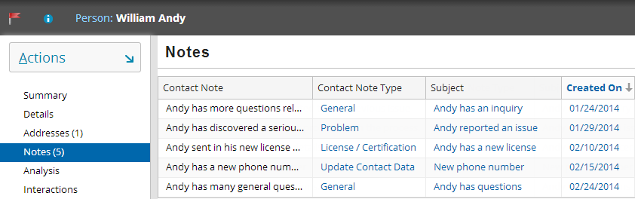
Use screenshot to answer questons
What is the array method to return the number of objects in the ContactNotes array? What is the value?
What is the expression to return the count of notes that are regarding a problem? What is the count value?
What is an expression to return an array of ContactNotes where the note was created after January 31, 2014?
Notes:
Answers
1) var count = array.length or array.Count.
The total number of elements in the ContactNotes array is 5.
2) var countNotes = notes.countWhere( \ note -> note.ContactNoteType == typekey.ContactNoteType.TC_PROBLEM)
The total number of elements in the ContactNotes array is 1.
3) var filteredNotes = notes.where( \ note -> note.CreateTime >= "02/01/2014" as java.util.Date )

